Slide 1

Word Search Solver: Implementing Backtracking for Word Search Puzzles

Slide 2
OBJECTIVES:
The objective of implementing backtracking for a word search puzzle solver is to efficiently find all occurrences of given words within a grid of letters. Backtracking is a systematic approach to solving such puzzles by exploring all possible paths until a solution is found or deemed impossible. This algorithm ensures that every possible combination of letters is considered while searching for the target words.

Slide 3

WORD SEARCH SOLVER

Slide 4
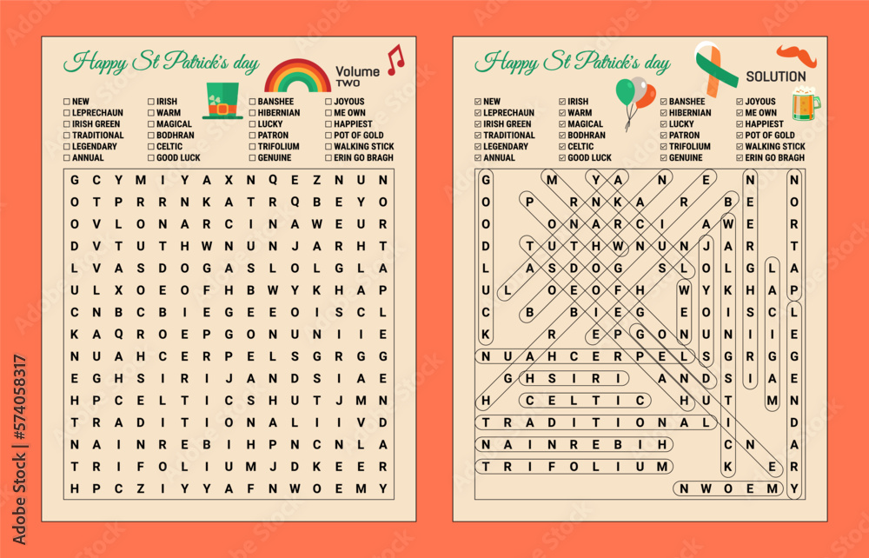

Slide 5
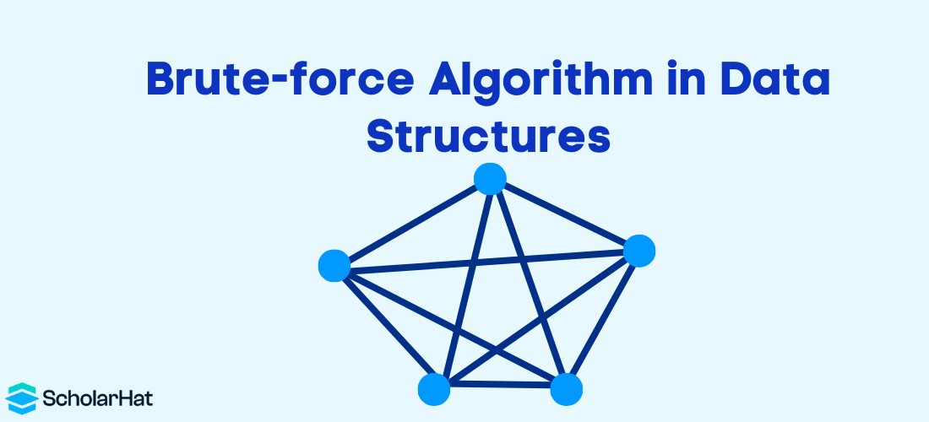

Slide 6
What is brute force algorithms?
Brute Force is a straightforward method used in algorithmic problem-solving that checks every possible solution until the correct one is found. Brute Force Algorithms function by searching each element sequentially until the desired result is found or all options are exhausted.
Is the brute force algorithm efficient?
2 Disadvantages of brute force algorithms
One of the main disadvantages of brute force algorithms is that they are very inefficient and time-consuming. They can consume a lot of computational resources, such as memory, CPU, or network bandwidth, depending on the size and complexity of the problem.

Slide 7
What is the brute force matching algorithm?
The Brute Force algorithm compares the pattern to the text, one character at a time, until unmatching characters are found: - Compared characters are italicized. - Correct matches are in boldface type.
Why do we use brute force algorithm?
Advantages of Brute Force Algorithm
Correctness: By systematically considering all possible solutions, a brute force algorithm guarantees to find the optimal solution, if one exists. It exhaustively checks all possibilities, leaving no room for overlooking potential solutions.

Slide 8


Slide 9
BACKTRACKING
Backtracking algorithms are like problem-solving strategies that help explore different options to find the best solution. They work by trying out different paths and if one doesn’t work, they backtrack and try another until they find the right one. It’s like solving a puzzle by testing different pieces until they fit together perfectly.
What is Backtracking?
Backtracking is a problem-solving algorithmic technique that involves finding a solution incrementally by trying different options and undoing them if they lead to a dead end. It is commonly used in situations where you need to explore multiple possibilities to solve a problem, like searching for a path in a maze or solving puzzles like Sudoku. When a dead end is reached, the algorithm backtracks to the previous decision point and explores a different path until a solution is found or all possibilities have been exhausted.

Slide 10
Types of Backtracking Problems
Problems associated with backtracking can be categorized into 3 categories:
Decision Problems: Here, we search for a feasible solution.
Optimization Problems: For this type, we search for the best solution.
Enumeration Problems: We find set of all possible feasible solutions to the problems of this type.
How does Backtracking works?
As we know backtracking algorithm explores each and every possible path in order to find a valid solution, this exploration of path can be easily understood via given images:

Slide 11
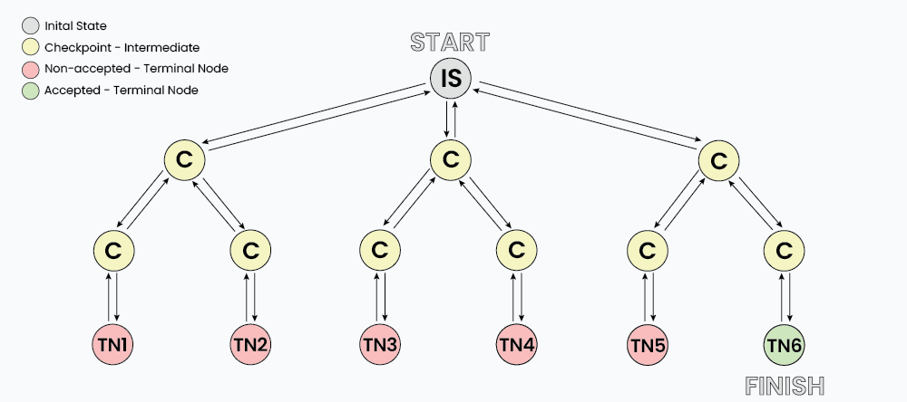

Slide 12
As shown in the image, “IS” represents the Initial State where the recursion call starts to find a valid solution.
C : it represents different Checkpoints for recursive calls
TN: it represents the Terminal Nodes where no further recursive calls can be made, these nodes act as base case of recursion and we determine whether the current solution is valid or not at this state.
At each Checkpoint, our program makes some decisions and move to other checkpoints untill it reaches a terminal Node, after determining whether a solution is valid or not, the program starts to revert back to the checkpoints and try to explore other paths. For example in the above image TN1…TN5 are the terminal node where the solution is not acceptable, while TN6 is the state where we found a valid solution.
The back arrows in the images shows backtracking in actions, where we revert the changes made by some checkpoint.

Slide 13
Determining Backtracking Problems:
Generally every constraint satisfaction problem can be solved using backtracking but, Is it optimal to use backtracking every time? Turns out NO, there are a vast number of problem that can be solved using Greedy or Dynamic programming in logarithmic or polynomial time complexity which is far better than exponential complexity of Backtracking. However many problems still exists that can only be solved using Backtracking.
To understand whether a problem is Backtracking based or not, let us take a simple problem:
Problem: Imagine you have 3 closed boxes, among which 2 are empty and 1 has a gold coin. Your task is to get the gold coin.
Why dynamic programming fails to solve this question: Does opening or closing one box has any effect on the other box? Turns out NO, each and every box is independent of each other and opening/closing state of one box can not determine the transition for other boxes. Hence DP fails.
Why greedy fails to solve this question: Greedy algorithm chooses a local maxima in order to get global maxima, but in this problem each and every box has equal probability of having a gold coin i.e 1/3 hence there is no criteria to make a greedy choice.

Slide 14
Why Backtracking works: As discussed already, backtracking algorithm is simply brute forcing each and every choice, hence we can one by one choose every box to find the gold coin, If a box is found empty we can close it back which acts as a Backtracking step.
Technically, for backtracking problems:
The algorithm builds a solution by exploring all possible paths created by the choices in the problem, this solution begins with an empty set S={}
Each choice creates a new sub-tree ‘s’ which we add into are set.
Now there exist two cases:
S+s is valid set
S+s is not valid set
In case the set is valid then we further make choices and repeat the process until a solution is found, otherwise we backtrack our decision of including ‘s’ and explore other paths until a solution is found or all the possible paths are exhausted.

Slide 16
Backtracking Vs Branch and Bound are discussed in this blog post. Backtracking is used to solve decision problems, whereas branch and bound is used to solve optimization problems.
Decision problems are normally answered with yes or no.
Optimization problems are those that seek to get the best possible solution from a given pool of solutions.
In that way, the branch and bound methods sit in the category of dynamic programming and greedy algorithms.
Nodes in the state-space tree are explored in depth-first order in the backtracking method.
Nodes in the tree may be explored in depth-first or breadth-first order in branch and bound method.

Slide 17
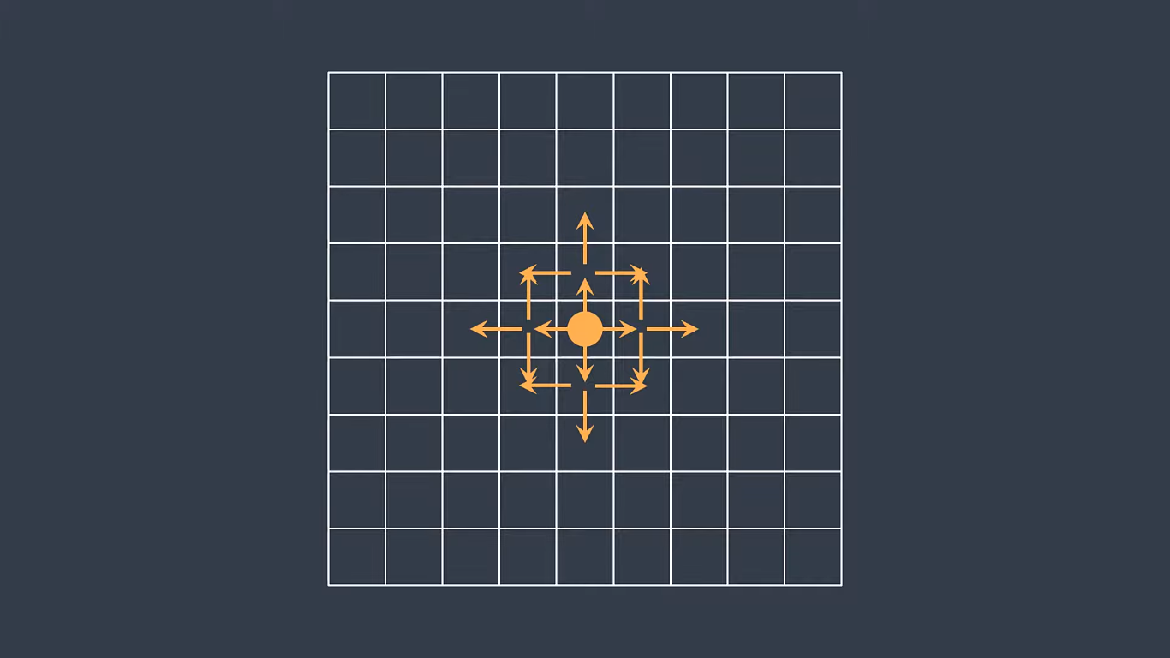
Brute-force---> Backtracking---> DFS---> recursive---> Direction

Slide 18
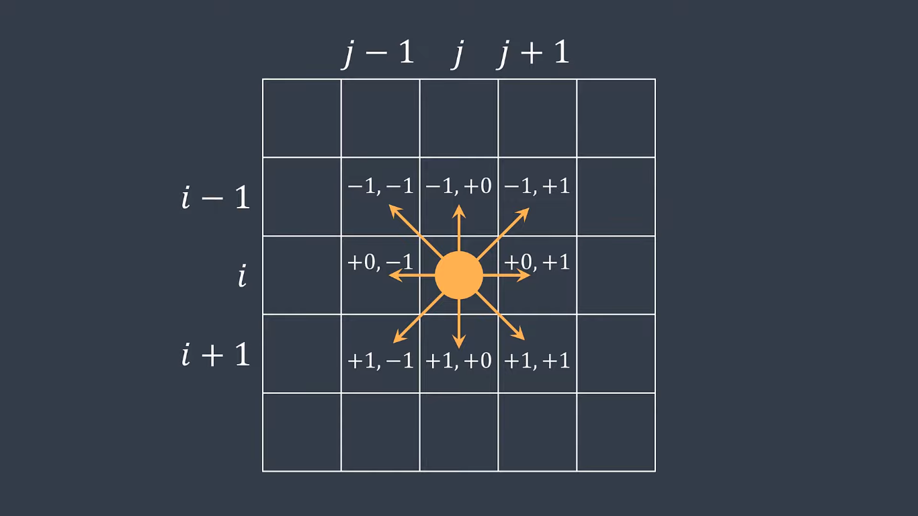

Slide 19
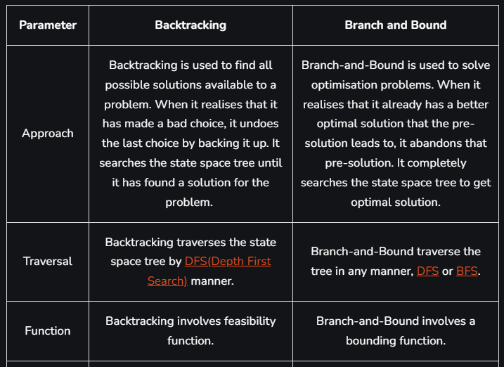

Slide 20
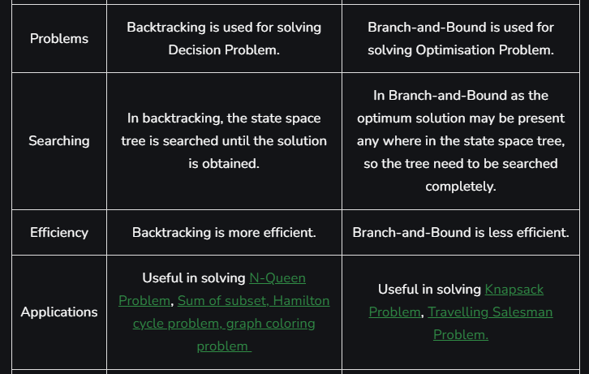

Slide 21
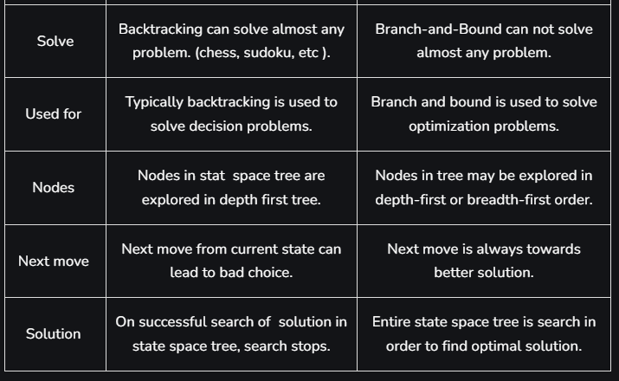

Slide 22
Complexity Analysis of Backtracking
Since backtracking algorithm is purely brute force therefore in terms of time complexity, it performs very poorly. Generally backtracking can be seen having below mentioned time complexities:
Exponential (O(K^N))
Factorial (O(N!))
These complexities are due to the fact that at each state we have multiple choices due to which the number of paths increases and sub-trees expand rapidly.
How Backtracking is different from Recursion?
Recursion and Backtracking are related concepts in computer science and programming, but they are not the same thing. Let’s explore the key differences between them:

Slide 23
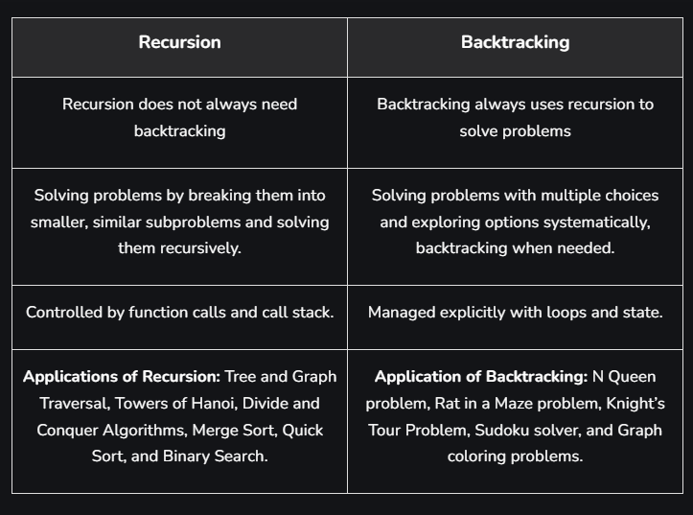
Difference between Backtracking and Recursion

Slide 24
Applications of Backtracking
Creating smart bots to play Board Games such as Chess.
Solving mazes and puzzles such as N-Queen problem.
Network Routing and Congestion Control.
Decryption
Text Justification
Backtracking Problems
N-Queen Problem
Solve Sudoku
M-coloring problem
Rat in a Maze
The Knight’s tour problem
Permutation of given String

Slide 25
Standard Problems on Backtracking:
The Knight’s tour problem
Rat in a Maze
N Queen Problem | Backtracking-3
Subset Sum problem
m Coloring Problem
Hamiltonian Cycle
Sudoku | Backtracking-7
Magnet Puzzle
Remove Invalid Parentheses
A backtracking approach to generate n bit Gray Codes
Write a program to print all permutations of a given string

Slide 26
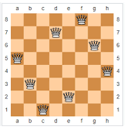
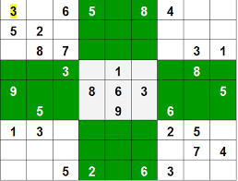
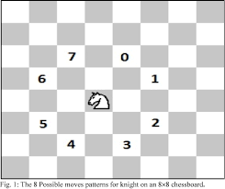
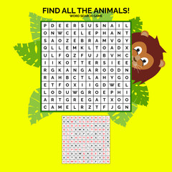
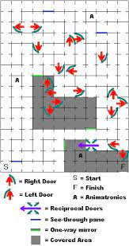
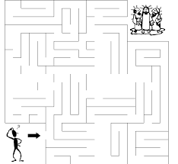
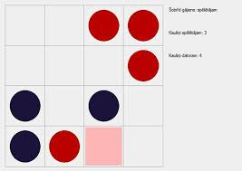

Slide 27
Trie Tree

Slide 28
Definition:
A trie (derived from retrieval) is a multiway tree data structure used for storing strings over an alphabet. It is used to store a large amount of strings. The pattern matching can be done efficiently using tries.
The trie shows words like allot, alone, ant, and, are, bat, bad. The idea is that all strings sharing common prefix should come from a common node. The tries are used in spell checking programs.
Preprocessing pattern improves the performance of pattern matching algorithm. But if a text is very large then it is better to preprocess text instead of pattern for efficient search.
A trie is a data structure that supports pattern matching queries in time proportional to the pattern size.
If we store keys in a binary search tree, a well balanced BST will need time proportional to M * log N, where M is the maximum string length and N is the number of keys in the tree. Using Trie, the key can be searched in O(M) time.

Slide 29
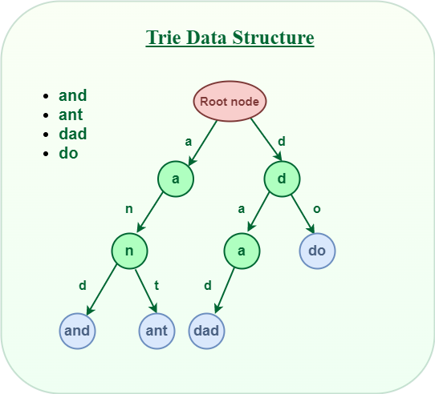

Slide 30
Properties of a Trie Data Structure
Now we already know that Trie has a tree-like structure. So, it is very important to know its properties.
Below are some important properties of the Trie data structure:
There is one root node in each Trie.
Each node of a Trie represents a string and each edge represents a character.
Every node consists of hashmaps or an array of pointers, with each index representing a character and a flag to indicate if any string ends at the current node.
Trie data structure can contain any number of characters including alphabets, numbers, and special characters. But for this article, we will discuss strings with characters a-z. Therefore, only 26 pointers need for every node, where the 0th index represents ‘a’ and the 25th index represents ‘z’ characters.
Each path from the root to any node represents a word or string.

Slide 31
Structure of Trie node:
Every node of Trie consists of multiple branches. Each branch represents a possible character of keys. Mark the last node of every key as the end of the word node. A Trie node field isEndOfWord is used to distinguish the node as the end of the word node.
A simple structure to represent nodes of the English alphabet can be as follows.
class TrieNode:
# Trie node class
def __init__(self):
self.children = [None for _ in range(26)]
# isEndOfWord is True if node represent the end of the word
self.isEndOfWord = False

Slide 32
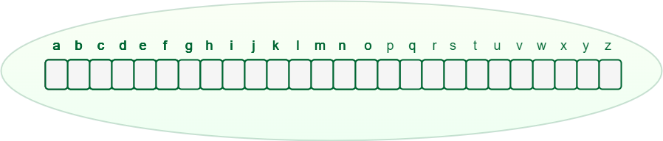
How does Trie Data Structure work?
We already know that the Trie data structure can contain any number of characters including alphabets, numbers, and special characters. But for this article, we will discuss strings with characters a-z. Therefore, only 26 pointers need for every node, where the 0th index represents ‘a’ and the 25th index represents ‘z’ characters.
Any lowercase English word can start with a-z, then the next letter of the word could be a-z, the third letter of the word again could be a-z, and so on. So for storing a word, we need to take an array (container) of size 26 and initially, all the characters are empty as there are no words and it will look as shown below.
An array of pointers inside every Trie node

Slide 33
Let’s see how a word “and” and “ant” is stored in the Trie data structure:
Store “and” in Trie data structure:
The word “and” starts with “a“, So we will mark the position “a” as filled in the Trie node, which represents the use of “a”.
After placing the first character, for the second character again there are 26 possibilities, So from “a“, again there is an array of size 26, for storing the 2nd character.
The second character is “n“, So from “a“, we will move to “n” and mark “n” in the 2nd array as used.
After “n“, the 3rd character is “d“, So mark the position “d” as used in the respective array.
Store “ant” in the Trie data structure:
The word “ant” starts with “a” and the position of “a” in the root node has already been filled. So, no need to fill it again, just move to the node ‘a‘ in Trie.
For the second character ‘n‘ we can observe that the position of ‘n’ in the ‘a’ node has already been filled. So, no need to fill it again, just move to node ‘n’ in Trie.
For the last character ‘t‘ of the word, The position for ‘t‘ in the ‘n‘ node is not filled. So, filled the position of ‘t‘ in ‘n‘ node and move to ‘t‘ node.
After storing the word “and” and “ant” the Trie will look like this:

Slide 34
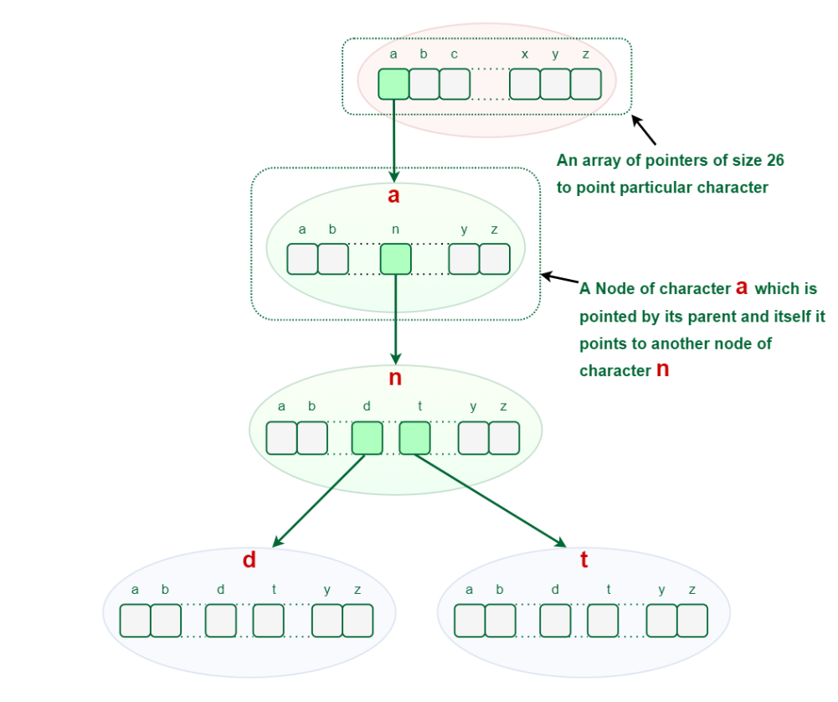

Slide 35
Representation of Trie Node:
# Python code
class TrieNode:
# Trie node class
def _init_(self):
self.children = [None for _ in range(26)]
# This will keep track of number of strings that are
# stored in the Trie from root node to any Trie node.
self.wordCount = 0
# This code is contributed by ishankhandelwals.

Slide 36
Basic Operations on Trie Data Structure:
Insertion
Search
Deletion
Insert Operation in Trie:
Inserting a key into Trie is a simple approach.
Every character of the input key is inserted as an individual Trie node. Note that the children is an array of pointers (or references) to next-level trie nodes.
The key character acts as an index to the array children.
If the input key is new or an extension of the existing key, construct non-existing nodes of the key, and mark the end of the word for the last node.
If the input key is a prefix of the existing key in Trie, Simply mark the last node of the key as the end of a word.
The key length determines Trie depth.
The following picture explains the construction of trie using keys given in the example below.

Slide 37
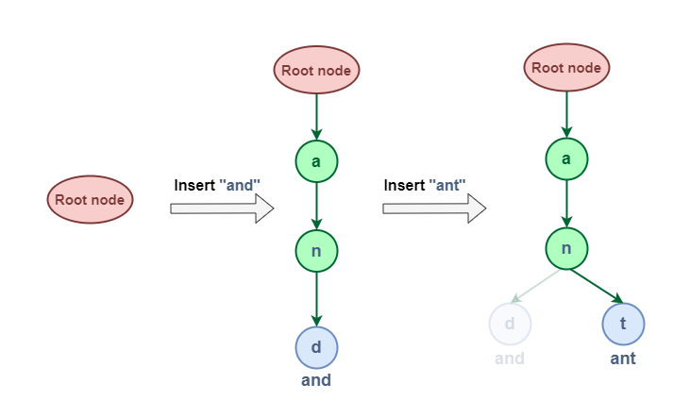

Slide 38
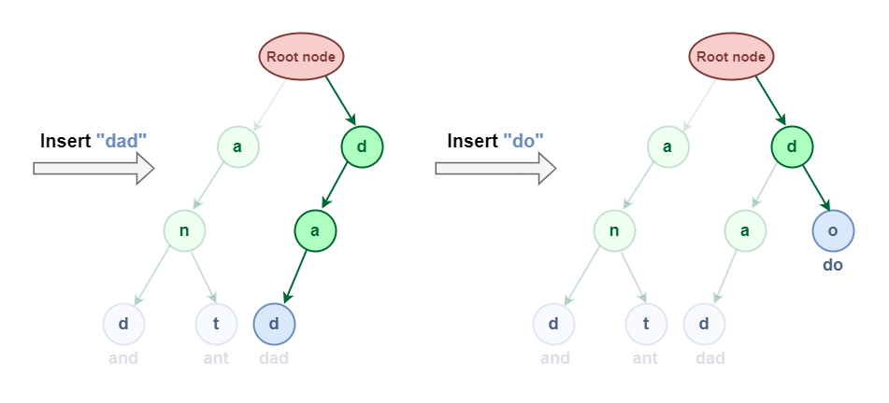

Slide 39
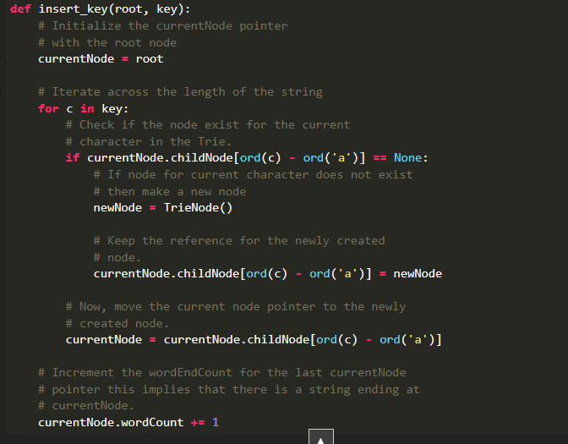

Slide 40
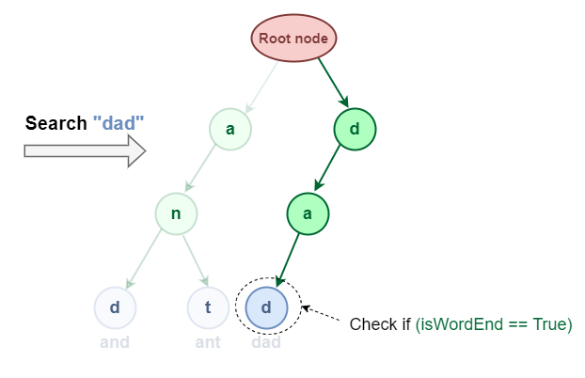
Search Operation in Trie:
Searching for a key is similar to the insert operation. However, It only compares the characters and moves down. The search can terminate due to the end of a string or lack of key in the trie.
In the former case, if the isEndofWord field of the last node is true, then the key exists in the trie.
In the second case, the search terminates without examining all the characters of the key, since the key is not present in the trie. Searching Complete word in Trie Data Structure:

Slide 41
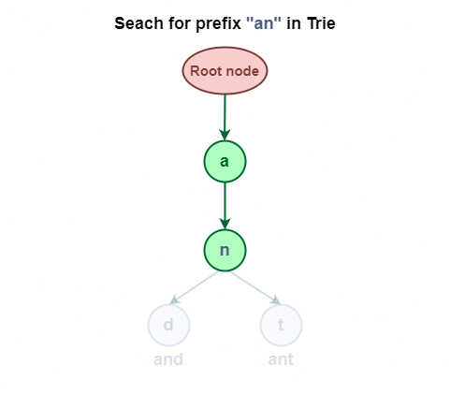
Searching Prefix in Trie Data Structure:

Slide 42
Note: Insert and search costs O(key_length), however, the memory requirements of Trie is O(ALPHABET_SIZE * key_length * N) where N is the number of keys in Trie. There are efficient representations of trie nodes (e.g. compressed trie, ternary search tree, etc.) to minimize the memory requirements of the trie.
Deletion in Trie Data Structure
This operation is used to delete strings from the Trie data structure. There are three cases when deleting a word from Trie.
The deleted word is a prefix of other words in Trie.
The deleted word shares a common prefix with other words in Trie.
The deleted word does not share any common prefix with other words in Trie.

Slide 43
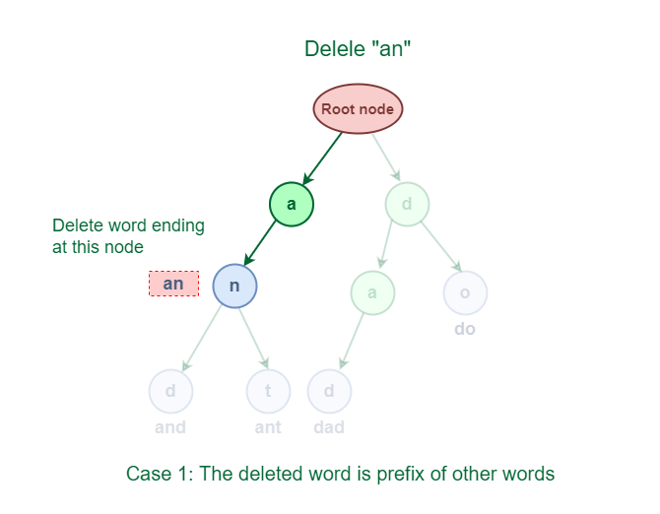

Slide 44
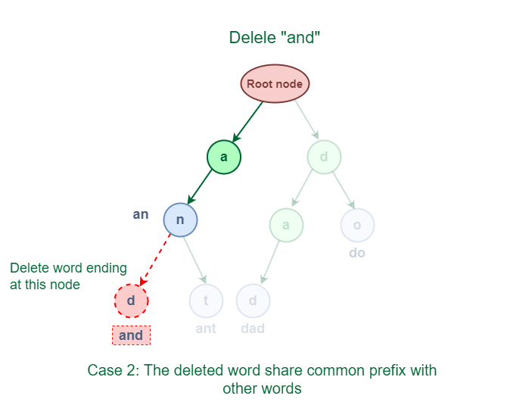

Slide 45
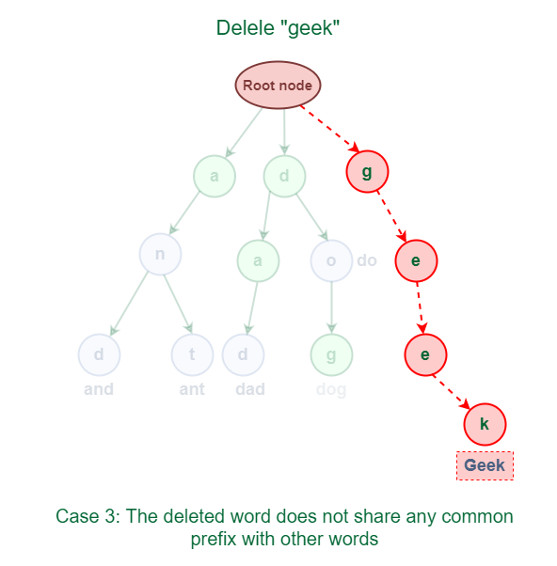

Slide 46
Applications of Trie data structure:
It has a wide variety of applications in data compression, computational biology, longest prefix matching algorithm used for routing tables for IP addresses, implementation of the dictionary, pattern searching, storing/querying XML documents, etc.
Real-time applications of Trie data structure:
Browser History: Web browsers keep track of the history of websites visited by the user So when the prefix of a previously visited URL is written in the address bar the user would be given suggestions of the website to visit.
Trie is used by storing the number of visits to a website as the key value and organizing this history on the Trie data structure
AutoComplete: It is one of the most important applications of trie data structure. This feature speeds up interactions between a user and the application and greatly enhances the user experience. Auto Complete feature is used by web browsers, email, search engines, code editors, command-line interpreters(CLI), and word processors.
Trie provides the alphabetical ordering of data by keys. Trie is used because it is the fastest for auto-complete suggestions, even in the worst case, it is O(n) (where n is the string length ) times faster than the alternate imperfect hash table algorithm and also overcomes the problem of key collisions in imperfect hash tables.

Slide 47


Slide 48

Spell Checkers/Auto-correct:
It is a 3-step process that includes :
Checking for the word in the data dictionary.
Generating potential suggestions.
Sorting the suggestions with higher priority on top.
Trie stores the data dictionary and makes it easier to build an algorithm for searching the word from the dictionary and provides the list of valid words for the suggestion.

Slide 49
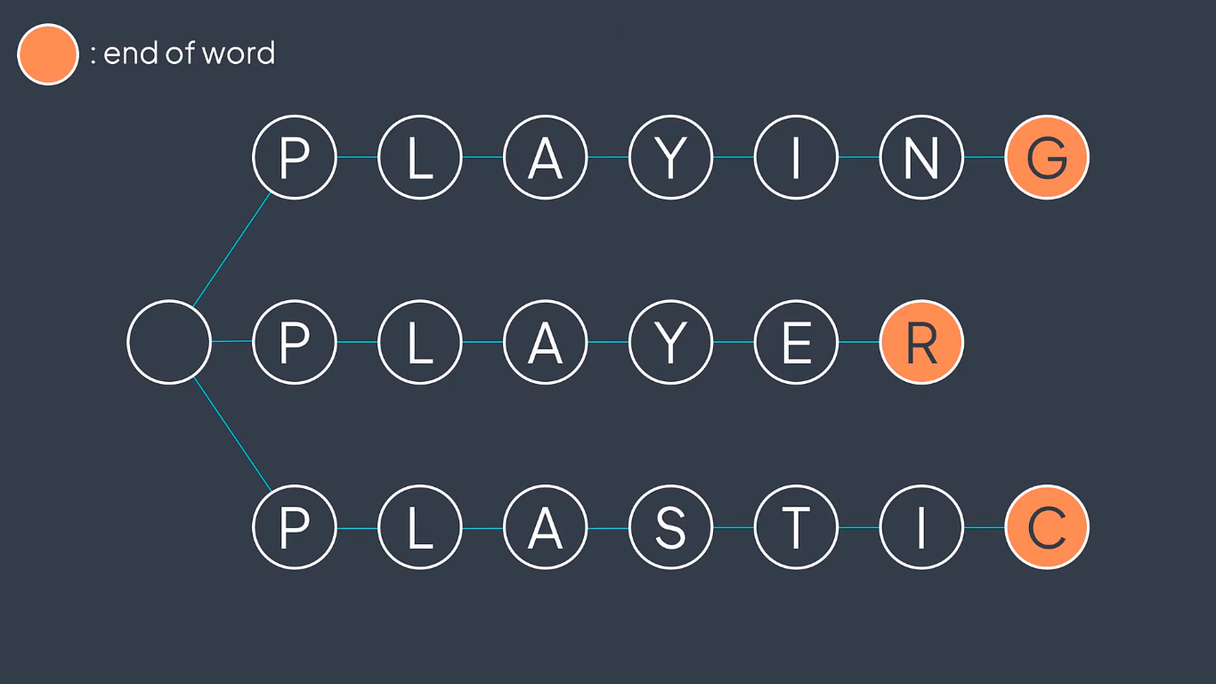

Slide 50
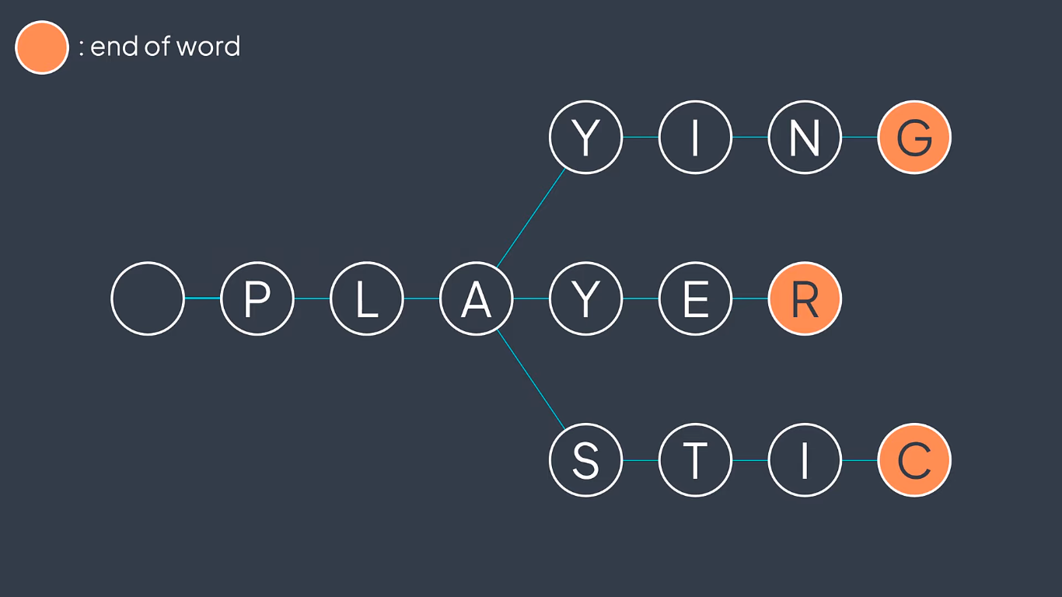

Slide 51
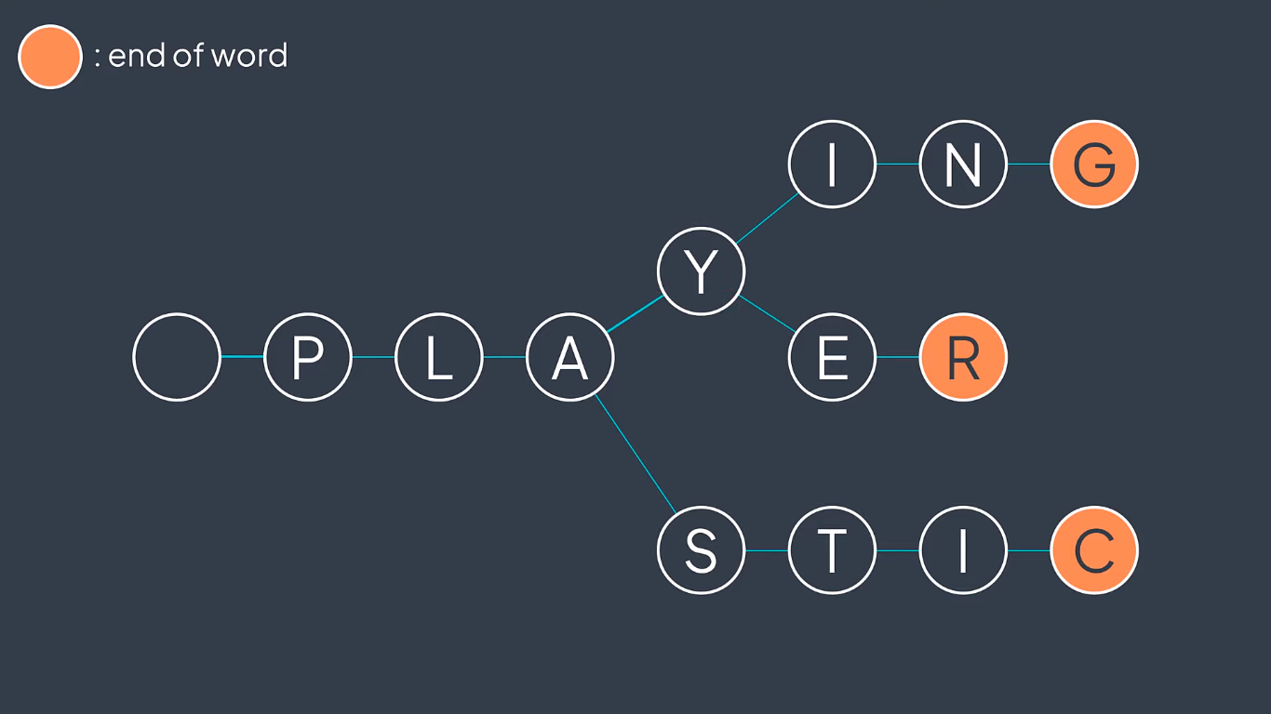

Slide 52
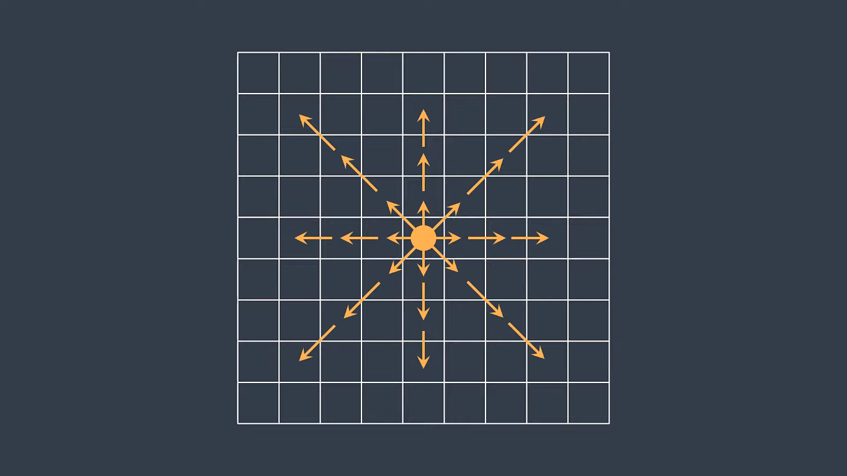
Trie tree---> normal loop---> Iteration---> Direction

Slide 53
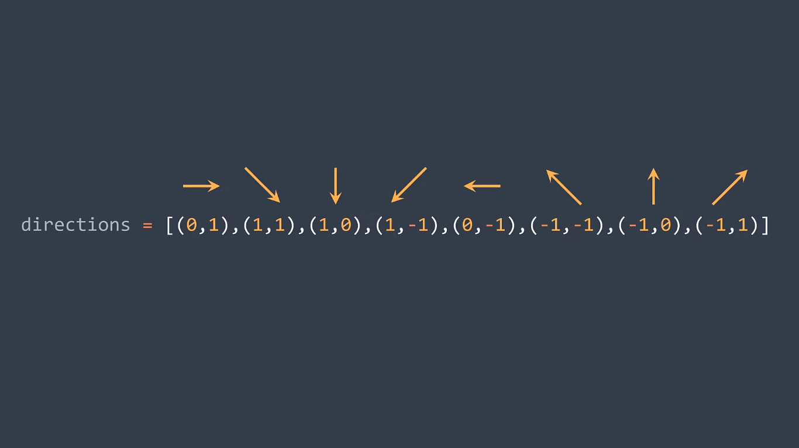

Slide 54
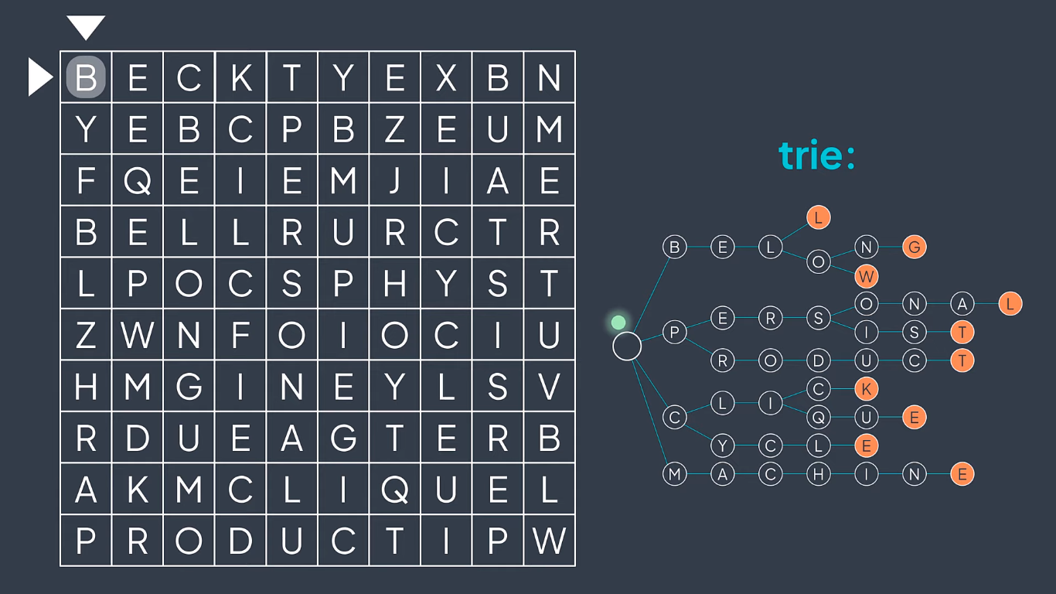

Slide 55
ALGORITHM

Slide 56
Initialize:
Create a grid of letters representing the word search puzzle.
Define a list of words to search for.
Initialize an empty list to store the positions of found words.
Backtracking Function:
Define a recursive backtracking function that takes parameters:
Current position in the grid (row, column).
Current index of the word being searched.
Current direction of exploration (horizontal, vertical, diagonal).
Path: the letters visited so far.
Base case:
If the current position is out of bounds or the letter at the current position does not match the letter in the word at the current index, return.
If the word is found, add its position to the list of found words.

Slide 57
Recursive case:
Explore all possible directions (up, down, left, right, diagonal) from the current position.
For each valid direction:
Update the position.
Update the path with the current letter.
Call the backtracking function recursively with updated parameters.
Backtrack by undoing the changes made (resetting position and path) after exploring each direction.
Search for Words:
Iterate through each cell in the grid.
For each cell, call the backtracking function with the current cell position and the list of words to search for.
Output:
Return the list of positions where each word was found.

Slide 58
FLOWCHART

Slide 59
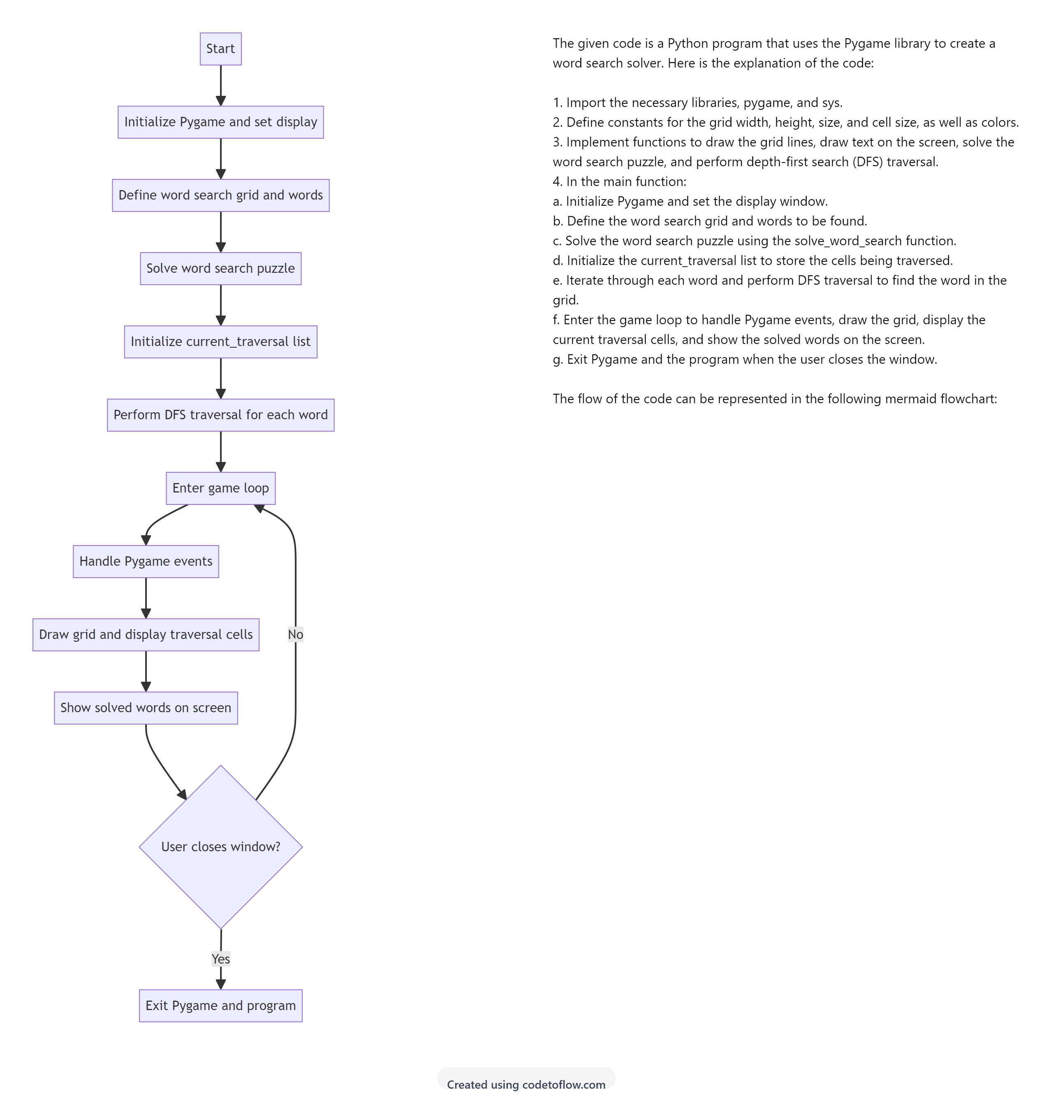

Slide 61
IMPLEMENTATION

Slide 62
import pygame
import sys
# Constants
GRID_WIDTH = 600
GRID_HEIGHT = 600
GRID_SIZE = 10
CELL_SIZE = GRID_WIDTH // GRID_SIZE
# Colors
WHITE = (255, 255, 255)
BLACK = (0, 0, 0)
RED = (255, 0, 0)
GREEN = (0, 255, 0)
def draw_grid(surface):
for x in range(0, GRID_WIDTH, CELL_SIZE):
pygame.draw.line(surface, BLACK, (x, 0), (x, GRID_HEIGHT))
for y in range(0, GRID_HEIGHT, CELL_SIZE):
pygame.draw.line(surface, BLACK, (0, y), (GRID_WIDTH, y))
def draw_text(surface, text, x, y, color=BLACK):
font = pygame.font.SysFont(None, 32)
text_surface = font.render(text, True, color)
text_rect = text_surface.get_rect(center=(x, y))
surface.blit(text_surface, text_rect)
def solve_word_search(grid, words):
solved_words = []
for word in words:
found = False
for i in range(GRID_SIZE):
for j in range(GRID_SIZE):
# Check horizontally
if word == ''.join(grid[i][j:j+len(word)]):
solved_words.append(word)
found = True
break
# Check vertically if the word fits within the grid
if i + len(word) <= GRID_SIZE and word == ''.join(grid[x][j] for x in range(i, i+len(word))):
solved_words.append(word)
found = True
break
if found:
break
return solved_words

Slide 63
def dfs_traversal(grid, visited, word, row, col, idx):
if idx == len(word):
return True
if row < 0 or col < 0 or row >= GRID_SIZE or col >= GRID_SIZE or visited[row][col] or grid[row][col] != word[idx]:
return False
visited[row][col] = True
if dfs_traversal(grid, visited, word, row+1, col, idx+1) or dfs_traversal(grid, visited, word, row-1, col, idx+1) or dfs_traversal(grid, visited, word, row, col+1, idx+1) or dfs_traversal(grid, visited, word, row, col-1, idx+1) or dfs_traversal(grid, visited, word, row+1, col+1, idx+1) or dfs_traversal(grid, visited, word, row-1, col-1, idx+1) or dfs_traversal(grid, visited, word, row+1, col-1, idx+1) or dfs_traversal(grid, visited, word, row-1, col+1, idx+1):
current_traversal.append((row, col))
return True
visited[row][col] = False
return False
def main():
pygame.init()
screen = pygame.display.set_mode((GRID_WIDTH, GRID_HEIGHT))
pygame.display.set_caption("Word Search Solver")
# Example word search grid and words
grid = [
['E', 'A', 'R', 'T', 'H', 'Q', 'U', 'A', 'K', 'Y'],
['S', 'E', 'E', 'T', 'R', 'E', 'E', 'Y', 'W', 'K'],
['G', 'O', 'L', 'D', 'E', 'N', 'R', 'N', 'E', 'L'],
['U', 'I', 'S', 'T', 'A', 'O', 'S', 'I', 'N', 'A'],
['C', 'A', 'T', 'S', 'N', 'S', 'I', 'A', 'T', 'D'],
['S', 'E', 'A', 'C', 'O', 'N', 'S', 'S', 'N', 'S'],
['U', 'I', 'S', 'T', 'A', 'R', 'S', 'I', 'N', 'A'],
['L', 'I', 'S', 'T', 'E', 'N', 'I', 'N', 'G', 'S'],
['I', 'A', 'P', 'P', 'L', 'R', 'S', 'I', 'N', 'A'],
['S', 'U', 'N', 'S', 'H', 'I', 'N', 'E', 'N', 'T']
]
words = ['EARTH', 'TREE', 'SUN', 'GOLD', 'STAR', 'CAT', 'SEASON', 'APPLE', 'LISTENING']
solved_words = solve_word_search(grid, words)
global current_traversal
current_traversal = [] # Store the cells being traversed

Slide 64
for word in words:
visited = [[False]*GRID_SIZE for _ in range(GRID_SIZE)]
for i in range(GRID_SIZE):
for j in range(GRID_SIZE):
if dfs_traversal(grid, visited, word, i, j, 0):
break
else:
continue
break
running = True
while running:
for event in pygame.event.get():
if event.type == pygame.QUIT:
running = False
screen.fill(WHITE)
draw_grid(screen)
for i in range(GRID_SIZE):
for j in range(GRID_SIZE):
color = BLACK
if (i, j) in current_traversal:
color = RED
draw_text(screen, grid[i][j], j * CELL_SIZE + CELL_SIZE // 2, i * CELL_SIZE + CELL_SIZE // 2, color)
for word in solved_words:
draw_text(screen, word, GRID_WIDTH // 2, GRID_HEIGHT + 20 + 32 * solved_words.index(word), GREEN)
pygame.display.flip()
pygame.quit()
sys.exit()
if __name__ == "__main__":
main()

Slide 65
END

